Slide 1


The Moody Buddy
The perfect app to track and manage your mood

Slide 2

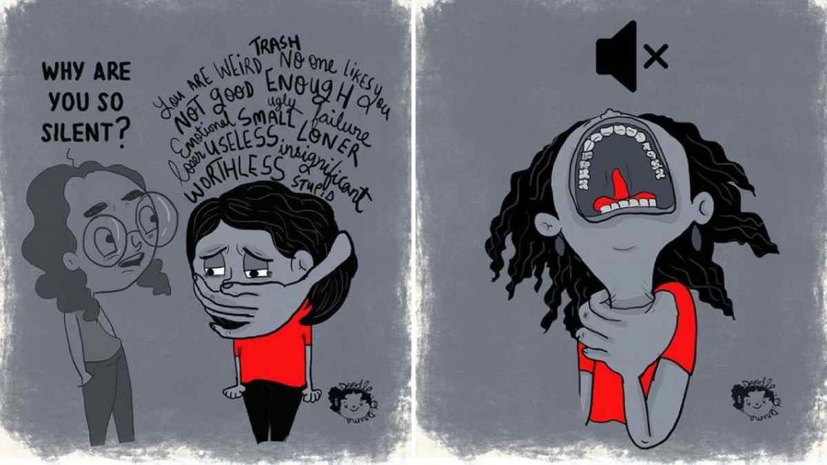
Introduction to the problem
In these 21st century where most of the time we spend on the internet, most primarily on the social networking sites, predicting our real and dear ones moods becomes a pretty tough deal. Sometimes we ourselves get confused about our own behavior.
Scientific studies says that one out of every five teenagers suffer from acute symptoms of clinical depression, frequent mood swings and uncontrollable anger. This number might seem small but when considered on a larger scale, this is a big issue to worry about. Repeated self-destructive exercises which one often unknowingly perform due to lack of motivation, compels them to do deeds which proves to be disturbing to both himself and the society.
Over indulgence on the social media has been the key destructive ingredient towards these aforesaid concerning issues. However it is almost impossible to cut out from ones social media life cause more than a practice it has become an addiction.

Slide 3

A closer look at the problem
Human beings are master of hiding their emotions. Hence the very first emotion detection device wasn’t that much effective. It was base on recognizing the facial and non-verbal expressions of a person. The device was highly recommended for autistic persons for expressing themselves in a much better version. However for the normal , glass-faced humans, emotion recognition device is yet a long way to go.

Slide 4

Proposed idea for solving the issue
As said earlier that technology is the core to all the problems, so we thought of employing the technology to solve the problem which it has created.
Our outlook for solving the problem is by developing an Application which could analyze and calculate the mood and emotion of the user to very close to accuracy.
The name of our app “The Moody Buddy” is kept thinking about a friend or a buddy who will always be there to analyze, support and solve all our emotional up and downs.
The
Moody
Buddy

Slide 5
Lets talk technology
* Our app will concentrate primarily on analyzing the emotional characteristics and calculating the sentimental factors and hence detecting the moods as accurate as possible.
*For that we need two components: 1. Users permission as well as the concerned social media industry’s license to read and analyze the day to day activities of the use, the amount of time for which the user uses a particular app and the contents posted and liked by the user.
2. Any kind of heart rate monitoring device(like Fit Bit) ,
preferably a heart beat monitoring watch.
*At first our app will built its very own stack of data libraries where all the words in the English dictionary will be recorded and segmented into three categories like: POSITIVE , NEUTRAL & NEGATIVE.
For example: If the user posts something in Twitter that contains words like Good, beautiful, happy etc. , these keywords will be counted to be POSITIVE.
The essence of this functionality is taken from the concept of Sentiment analysis, where in the algorithm we use natural language processing(NPL) to classify th documents in the same segregation of POSITIVE, NEUTRAL & NEGATIVE.
Anything the user will post or write on social media platforms will be temporarily stored and feed to the Sentiment Analysis algorithm.

Slide 6
Once the data is fed to the algorithm, the segmentations according to the keyword analysis takes place where each and every sentences i.e. the distance between one full-stop to another full-stop is scanned word by word and simultaneously checked with our keyword libraries and the number of POSITIVE , NEGATIVE words are calculated.
In case of sentences containing both positive and negative words and are used in a contradictory way, Advance algorithm is used.
For e.g. : “The service was terrible, but the food was really good” , in these kind of sentences, the whole paragraph is split into sentences and each sentence is analyzed word by word instead of making a cumulative conclusion and such kind of sentences are categorized under NEUTRAL.
*Another way of analysis would be Mood analysis through Emoji
Emoji are a source of information about the content, the state of the communicator and possibly the intended effect on the recipient of the communication. As such, they should be subject to analysis just like any other part of the source material.
We can achieve it simply by using Tensorflow’s Object Detection API tool which helps to built to deploy powerful Emoji recognition software.
All these informations will be updated after a time period of 12 hours after which a cumulative result will be provided.

Slide 7
*
Last but not the least, in order to get accurate results we are implementing a heart rate monitoring device. The user can use the device as a watch to wear which will record the heart rate of the user for collecting data every minutes.
According to medical science the normal heart rate of a human is 72 beats per minutes. If the heart rate is higher than the normal limit for a prolonged period that is more than 15 mins than two assumptions can be made: 1. The user is angry or tensed.
2. The user is excited.
Accordingly a notification will be fetched to the user where a questionnaires of 10 questions will be popped up. If the user attempts to take the questions, then the no. of no's and no. of yes would help to detect the mood.
If the no. of yes is more than the user might be angry/tensed and if the no. of no's is more than it will be mere excitement.
Excited~~
Angry~~
Tensed~~

Slide 8
*If the heart rate is less than the normal rate than there might be two possibilities which says
the person might be depressed or his he is suffering from an ailment.
Whenever such abnormality will take place again the notification will pop up asking for permission to ask questions from the questionnaires which is such curated so that depending upon the no. of yes and no. of no's we can predict the current mood of the user.
Depression and Anxiety~~

Slide 9
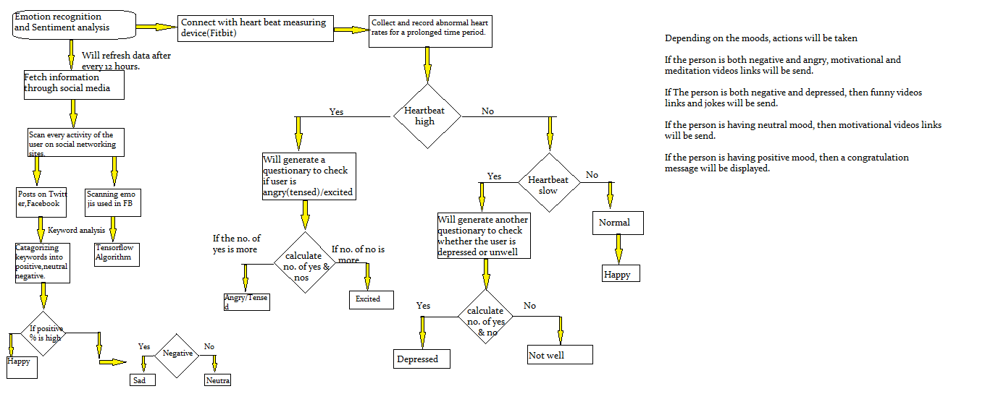
Flowchart of operation of “The Moody Buddy”

Slide 10
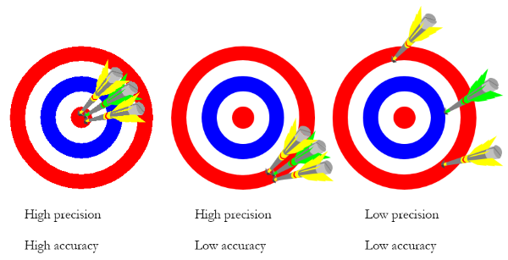
attempt to solve the issue
Whenever there will be any kind of abnormality in the functioning of the heart, by virtue of machine learning we can make two devices talk to each other and pop up notification will take place.
Even if the user ignores the pop up notification, the cumulative of all data and analyzing it with through keyword usage examination we can break through the problems.
Moreover, the number of comparisons which we are aiming at i.e. the Emoji detection, keyword analysis and through heart rate monitoring, the chances of errors are highly diminished, as according to Probability theorem, more the number of comparisons made less will be the chances to have errors.
An

Slide 11
Thank you
Submitted by: Debalina De
Diksha Kushawaha
Chandigarh Group of Colleges
2nd Year

